Slide 1

Data Encryption Standard
Block Cipher & Stream Cipher, DES (Data Encryption Standard)

Slide 2
Group Members
UZAIR WAHEED ANJUM
MAHROSE FATIMA

Slide 3
Block Cipher
Types of cipher

Slide 4
Block Cipher – Definition
A block cipher is a method of encrypting data by dividing it into fixed-size blocks, and then applying a mathematical transformation to each block.

Slide 5
Block Cipher – Key Sizes
Block ciphers use keys to determine the transformation applied to each block. Key sizes are typically measured in bits, and larger key sizes provide stronger security.

Slide 6
Block Cipher – Modes of Operation
Block ciphers can be used in different modes of operation, such as Electronic Codebook (ECB) mode, Cipher Block Chaining (CBC) mode, and Counter (CTR) mode, to achieve different goals such as confidentiality, integrity, and authenticity.
Examples:
Some examples of popular block ciphers include AES (Advanced Encryption Standard), DES (Data Encryption Standard), and Blowfish.

Slide 7
Block Cipher – Security
The security of a block cipher depends on the key size and the strength of the underlying mathematical transformation. It is important to choose a block cipher with a key size that is appropriate for the level of security required.

Slide 8
Block Cipher – Limitations
One limitation of block ciphers is that they are deterministic, meaning that the same input will always produce the same output when encrypted with the same key. This can be a weakness in some applications, such as when encrypting a stream of data. In these cases, a different type of encryption, such as a stream cipher, may be more appropriate

Slide 9
Stream Cipher
Types of cipher

Slide 10
Stream Cipher – Definition
A stream cipher is a method of encrypting data by generating a stream of pseudorandom bits, called a keystream, and combining it with the plaintext data using the exclusive OR (XOR) operation.

Slide 11
Stream Cipher – Key Sizes
Stream ciphers use keys to generate the keystream. Key sizes are typically measured in bits, and larger key sizes provide stronger security.

Slide 12
Stream Cipher – Examples
Some examples of popular stream ciphers include RC4 (Rivest Cipher 4), Salsa20, and ChaCha20.

Slide 13
Stream Cipher – Security
The security of a stream cipher depends on the key size and the quality of the pseudorandom number generator used to generate the keystream. It is important to choose a stream cipher with a key size that is appropriate for the level of security required, and to use a high-quality pseudorandom number generator.

Slide 14
Stream Cipher – Advantages
Stream ciphers have the advantage of being faster and simpler to implement than block ciphers, and they can be more suitable for encrypting a stream of data.

Slide 15
Stream Cipher – Limitations
One limitation of stream ciphers is that they are susceptible to key reuse, which can compromise the security of the cipher. To avoid this, it is important to generate a new key for each message that is encrypted.

Slide 16
DES
Data Encryption Standard

Slide 17
DES – Introduction
Developed in early 1970’s at IBM and submitted to NBS.
DES is landmark in cryptographic algorithms.
DES works based on Feistel Cipher Structure.
DES is symmetric cipher algorithm and use block cipher method for encryption and decryption.

Slide 18
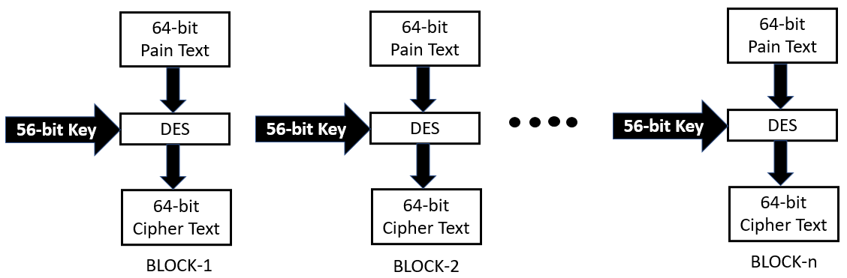
DES – Introduction

Slide 19
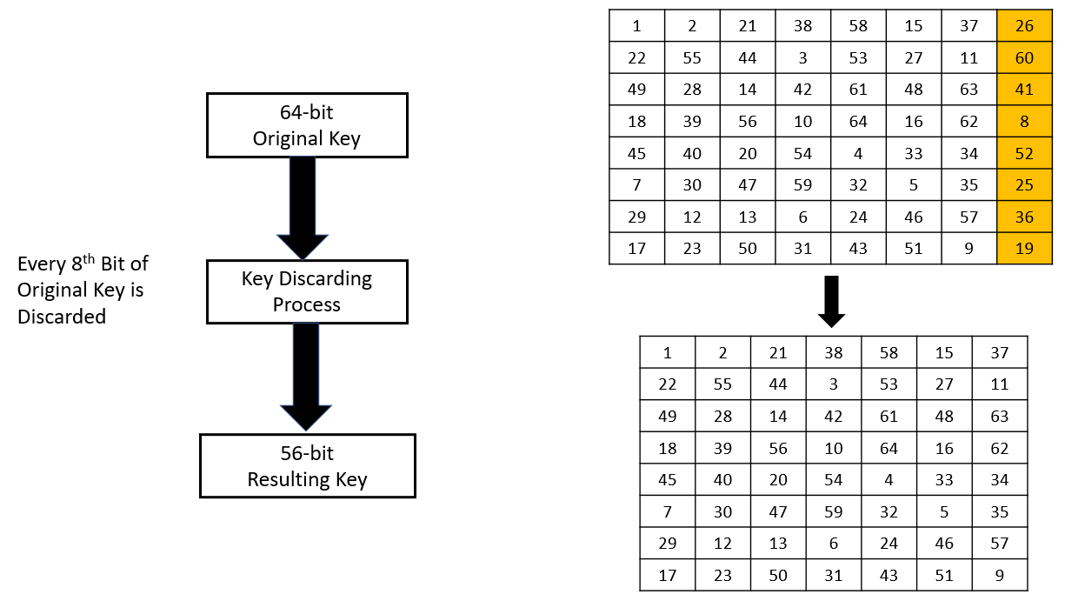
DES – Key Discarding Process

Slide 20
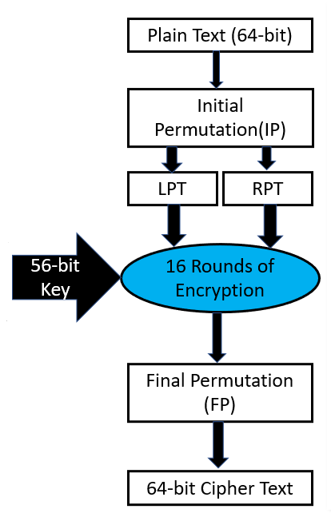
DES – Steps of DES
Step – 1: 64-bit plain text block is given to Initial Permutation (IP) function.
Step – 2: IP performed on 64-bit plain text block.
Step – 3: IP produced two halves of the permuted block known as Left Plain Text (LPT) and Right Plain Text (RPT).
Step – 4: Each LPT and RPT performed 16-rounds of encryption process.
Step – 5: LPT and RPT rejoined and Final Permutation (FP) is performed on combined block.
Step – 6: 64-bit Cipher text block is generated.

Slide 21
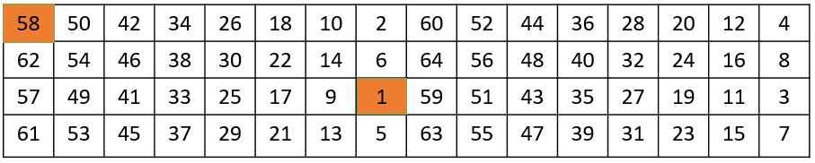
DES – Initial Permutation (IP) & Generate LPT-RPT
Initial Permutation performed only once.
Bit sequence have changed as per IP table.
For Example:
1st bit takes 40th Position
58th bit take 1st position
Output of IP is divided into two equal halves known as LPT, RPT. (LPT – 32 bits, RPT – 32 bit)

Slide 22
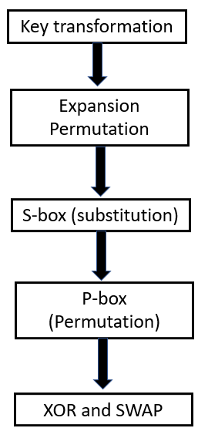
DES – 16 Rounds of Encryption
Step – 1: Key Transformation (56-bit key)
Key Bit Shifted per round
Compression Permutation
Step – 2: Expansion permutation of Plain Text and X-OR (P.T. size: 48 bit, C.T. size: 48 bit)
Step – 3: S-box Substitution
Step – 4: P-box (Permutation)
Step – 5: X-OR and Swap.

Slide 23

DES – Step – 1: Key Bit Shifted per Round
56-bit key is divided into two halves each of 28-bits.
Circular left shift is performed on each half.
Shifting of Bit position is depending on round.
For round number 1,2,9 and 16 shifts are done by one position.
For remaining rounds shift is done by 2 positions.

Slide 24
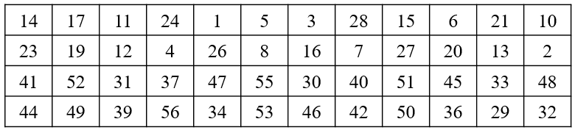
DES – Compression Permutation
56-bit input with bit shifting position
Generates 48-bit key (Compression of Key bit)
Drop 9, 18, 22, 25, 35, 38, 43 and 54 bits.
Generated 48 bits keys are as below:

Slide 25
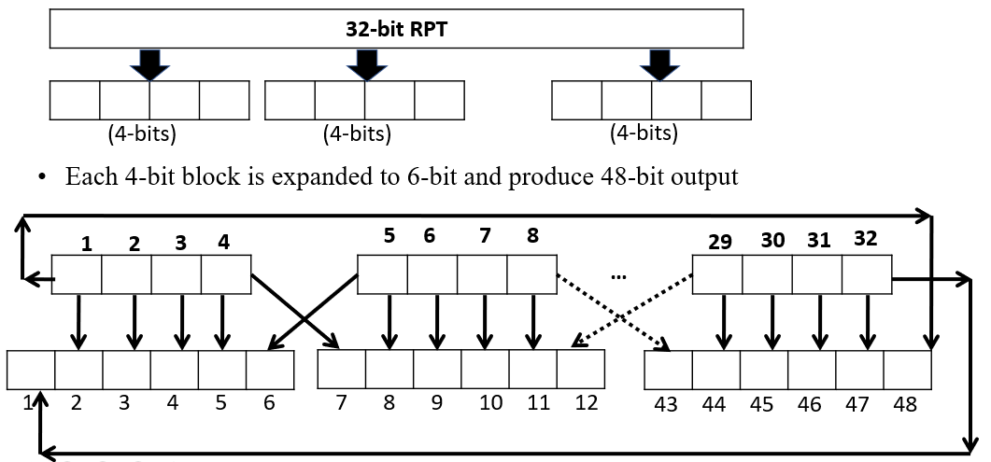
DES – Step – 2: Expansion Permutation & X-OR
32-bit RPT of IP is expanded to 48-bits
Expansion permutation steps:
32-bit RPT is divided into 8-blocks each of 4-bits

Slide 26
DES – Expansion Permutation
32-bit RPT of IP is expanded to 48-bits
Expansion permutation steps:
32-bit RPT is divided into 8-blocks each of 4-bits

Slide 27
DES – Expansion Permutation

Slide 28
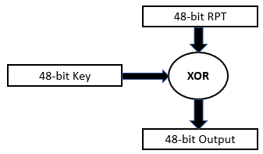
DES – X-OR
48-bit RPT is XORed with 48-bit Key and output is given to S-Box.

Slide 29
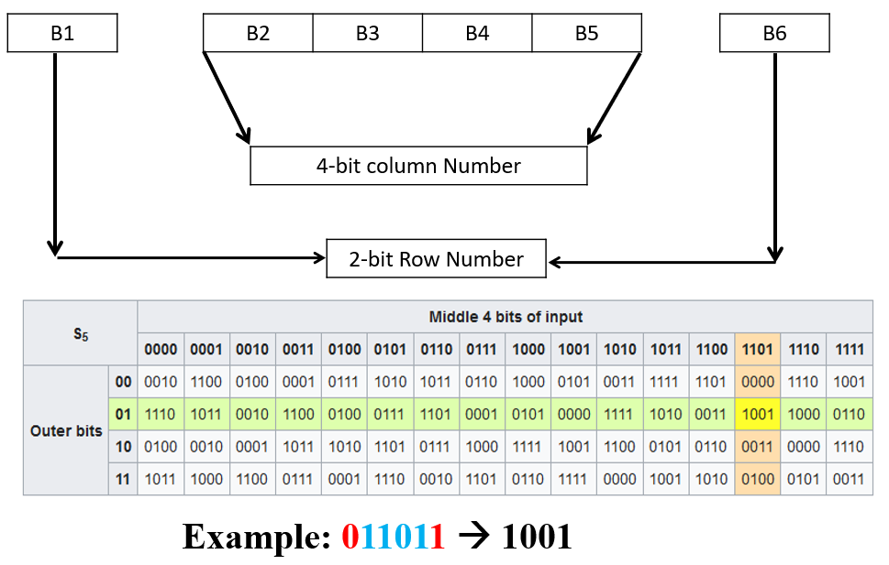
DES – Step – 3: S-BOX Substitution

Slide 30

DES – Step -4: P-BOX Permutation
Output of s-box is given to p-box
32-bit is permuted with 16 x 2 permutation table
For Example:
16th bit of S-box takes 1st Position as per below permutation table.

Slide 31
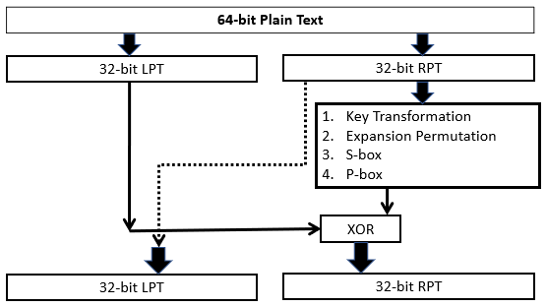
DES – Step – 5: XOR and SWAP
32-bit LPT is XORed with 32-bit p-box.

Slide 32
DES – Step – 2: Expansion Permutation & X-OR
1st round of encryption is completed. Now remaining 15 rounds will be performed same as 1st round.

Slide 33
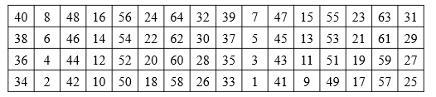
DES – Final Permutation
At the end of the 16 rounds, the final permutation is performed (only once).
For Example:
40th bit of input takes 1st Position as per below permutation table.
The output of the final permutation is the 64-bit encrypted block (64-bit cipher text block).

Slide 34
DES – Strength of DES
Key Length (Use of 56-bit Key): 256 Possible Keys (7.2 x 1016 Keys), Brute force attack takes more than thousand Years
Use of S-boxes: Complex Structure of S-box, Scope of attack is very less
DES is Reversible algorithm

Slide 35
DES – Weakness of DES
Trying all 256 possible keys are not much harder these days. If you spend at least $25 K you can build DES password crackers that will successes in few hours.
Two chosen input to an S-box can create the same output.
The purpose of initial and final permutation is not clear.

Slide 36
DES – Avalanche Effect in DES
The small change in Plain text or Key produce a significant change in the Cipher text.
DES Provide a strong Avalanche effect due to complexity of algorithm.

Slide 37
“The only secure message is the one that has not been sent.”
- Robert Morris

